Slide 1



Automated Reasoning about Software ($67532$)
Guy Katz
Lecture $10$: Deductive Verification December $30$^{th} , $2019$

Slide 2
Acknowledgements
Some of the material presented has been borrowed from slides by David Dill, Isil Dillig, Gera Weiss, Clark Barrett, Alex Aiken, Mooly Sagiv, Sagar Chaki and Ofer Strichman

Slide 3
Recap
SMT solvers: general purpose reasoning engines
Their language: first order logic (FOL)
Background theories naturally aimed at program analysis
This is a pretty big hammer!
Today, we will see some of the nails…

Slide 4







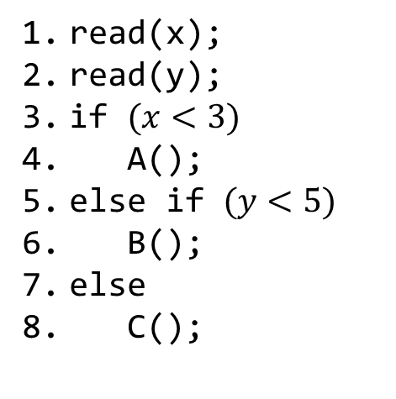

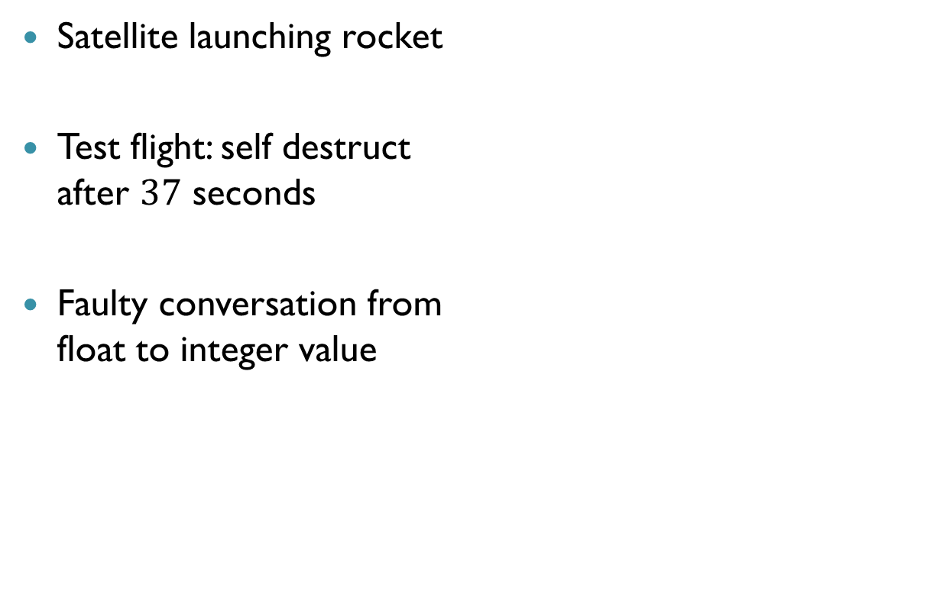


Symbolic Execution
$$x=0 y=0$$
$$x=4 y=0$$
read(x);
read(y);
if $(x<3)$
A();
else if $(y<5)$
B();
else
C();
$$x=4 y=6$$
if $(x<3)$
false
true
if $(y<5)$
A()
false
true
$$x<3$$
C()
B()
$$¬(x<3)∧y<5$$
SMT
$$¬\left(x<3\right)∧¬ (y<5)$$
$$¬(x<3)$$
$x=4$, $y=0$
$x=4$, $y=6$

Slide 5


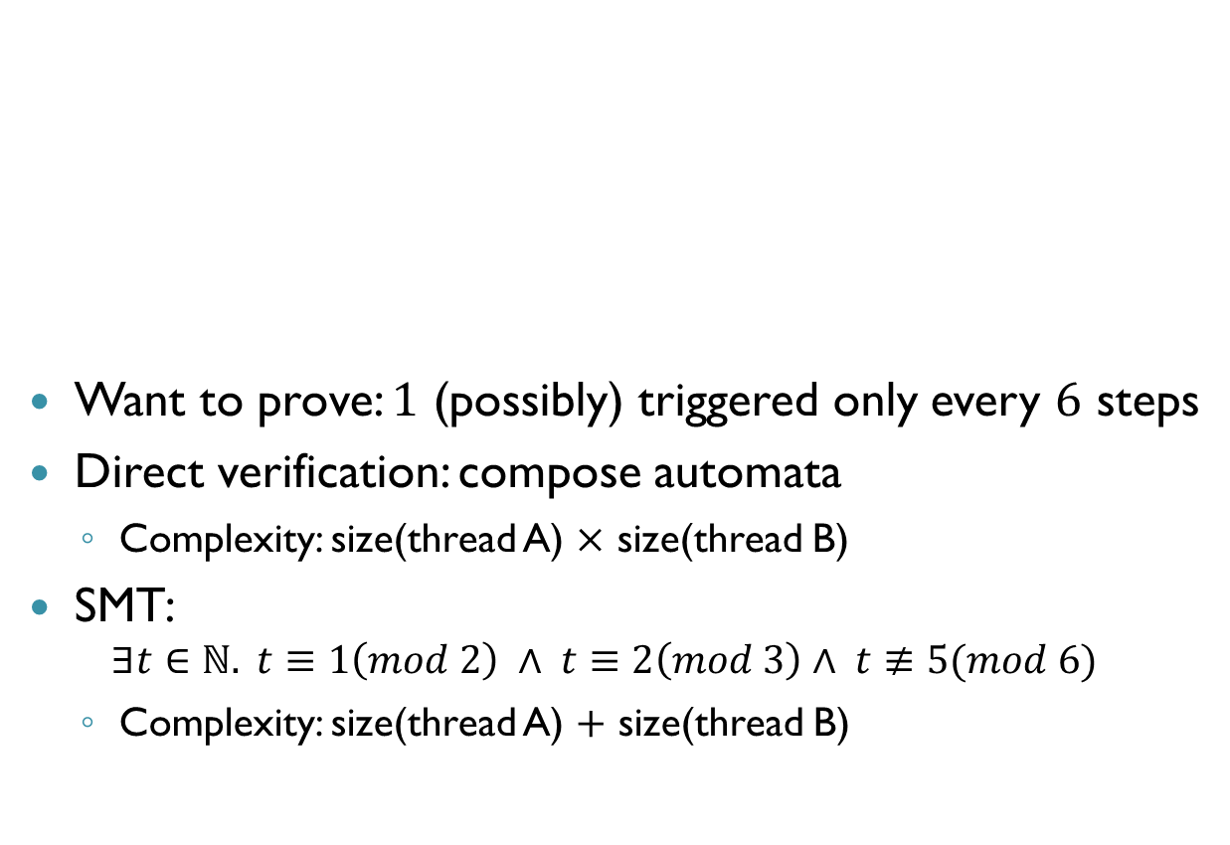




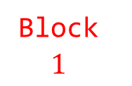
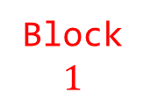

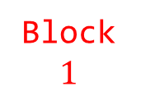





Compositional Verification
Want to prove: $1$ (possibly) triggered only every $6$ steps
Direct verification: compose automata
Complexity: size(thread A) $×$ size(thread B)
SMT:
$$∃t∈ℕ. t≡1\left(mod 2\right) ∧ t≡2\left(mod 3\right)∧ t≢5(mod 6)$$
Complexity: size(thread A) $+$ size(thread B)
Thread A
$$0, 1$$
Thread B
$$0, 1$$
$$p_{1}$$
$$p_{2}$$
$$p_{2}$$
$$q_{1}$$
$$q_{2}$$
$$q_{3}$$
$$q_{3}$$
$$0$$
$$0$$
$$0$$
Block $1$
Block $1$
Block $1$

Slide 6



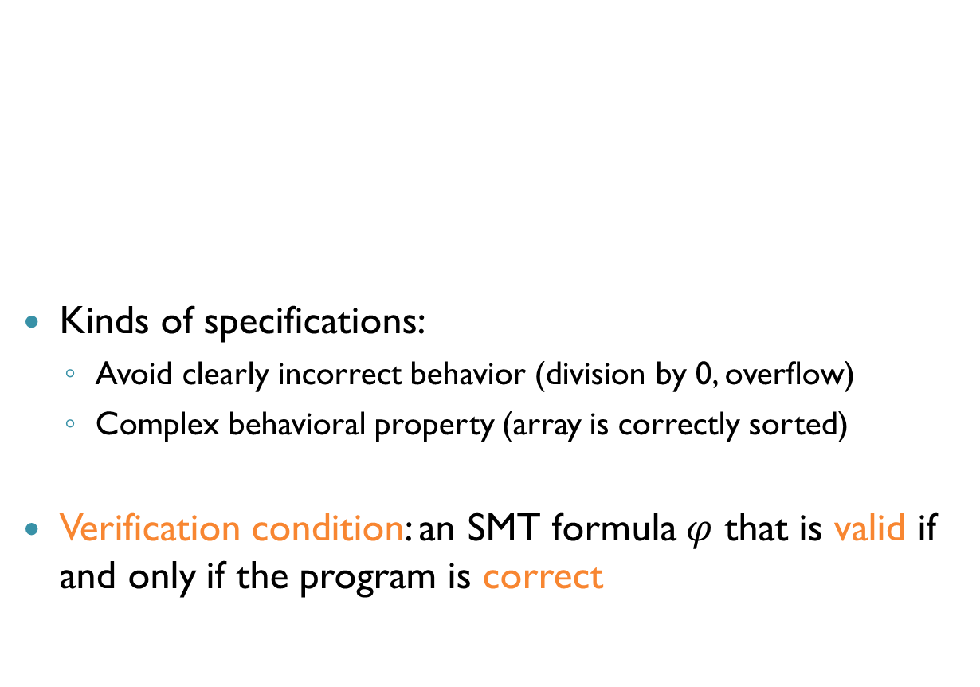
Deductive Program Verification
Kinds of specifications:
Avoid clearly incorrect behavior (division by 0, overflow)
Complex behavioral property (array is correctly sorted)
Verification condition: an SMT formula $φ$ that is valid if and only if the program is correct
Program
$$φ$$
Deductive Verifier
SMT Solver
Specification

Slide 7
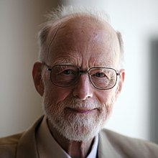

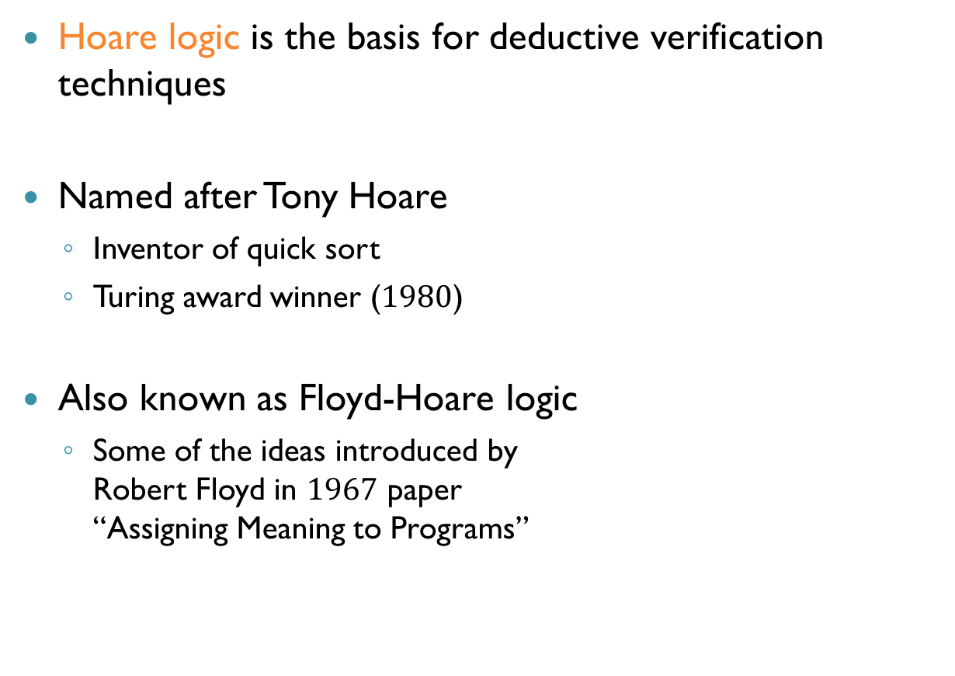
Hoare Logic
Hoare logic is the basis for deductive verification techniques
Named after Tony Hoare
Inventor of quick sort
Turing award winner ($1980$)
Also known as Floyd-Hoare logic
Some of the ideas introduced by Robert Floyd in $1967$ paper “Assigning Meaning to Programs”

Slide 8
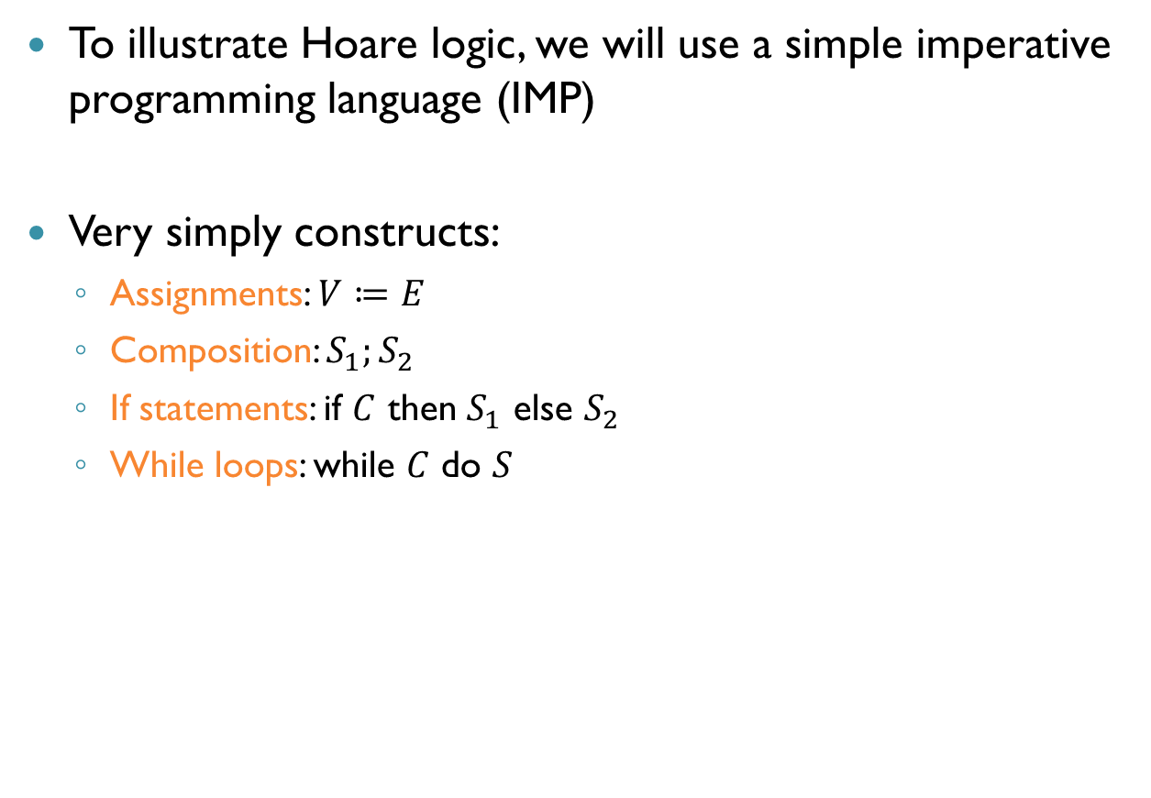
Imperative Programming Language
To illustrate Hoare logic, we will use a simple imperative programming language (IMP)
Very simply constructs:
Assignments: $V≔E$
Composition: $S_{1};S_{2}$
If statements: if $C$ then $S_{1}$ else $S_{2}$
While loops: while $C$ do $S$

Slide 9
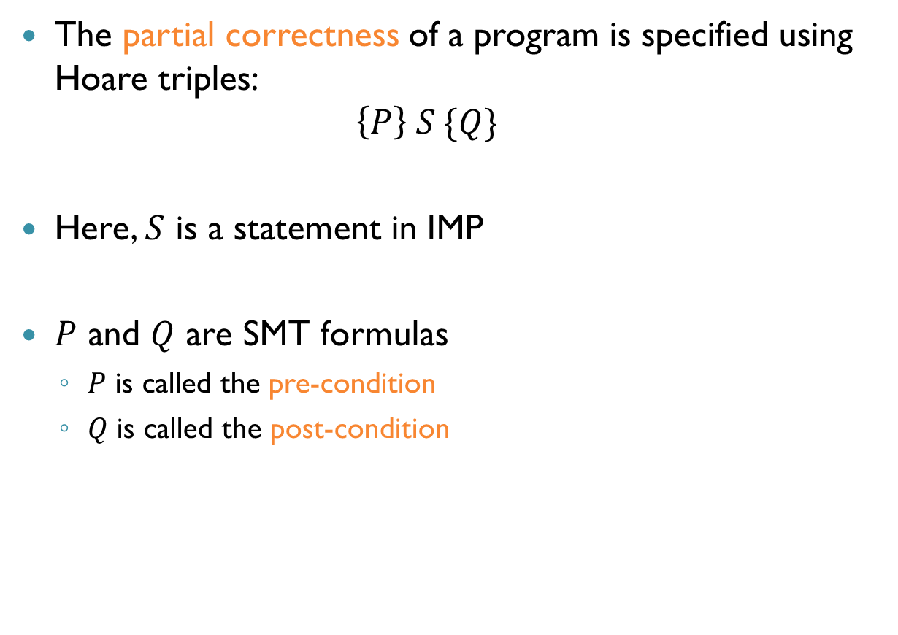
Partial Correctness Specification
The partial correctness of a program is specified using Hoare triples: $\left\{P\right\} S \{Q\}$
Here, $S$ is a statement in IMP
$P$ and $Q$ are SMT formulas
$P$ is called the pre-condition
$Q$ is called the post-condition

Slide 10
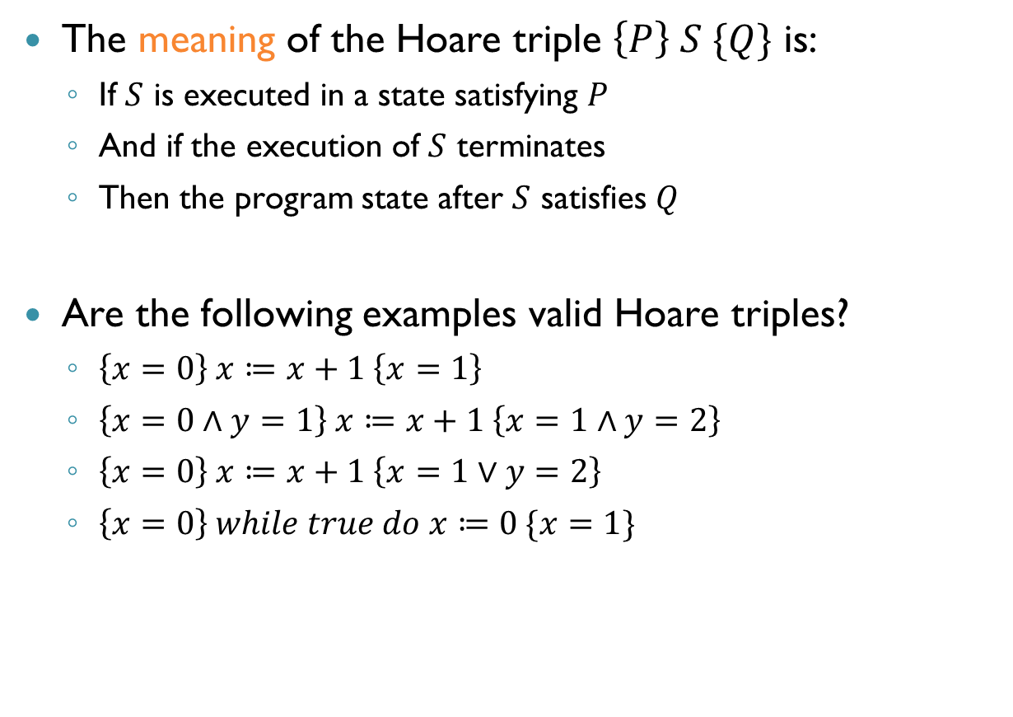
Meaning of Hoare Triples
The meaning of the Hoare triple $\left\{P\right\} S \{Q\}$ is:
If $S$ is executed in a state satisfying $P$
And if the execution of $S$ terminates
Then the program state after $S$ satisfies $Q$
Are the following examples valid Hoare triples?
$\left\{x=0\right\} x≔x+1 \left\{x=1\right\}$
$\left\{x=0∧y=1\right\} x≔x+1 \left\{x=1∧y=2\right\}$
$\left\{x=0\right\} x≔x+1 \left\{x=1∨y=2\right\}$
$\left\{x=0\right\} while true do x≔0 \{x=1\}$
Yes
No
Yes
Yes

Slide 11
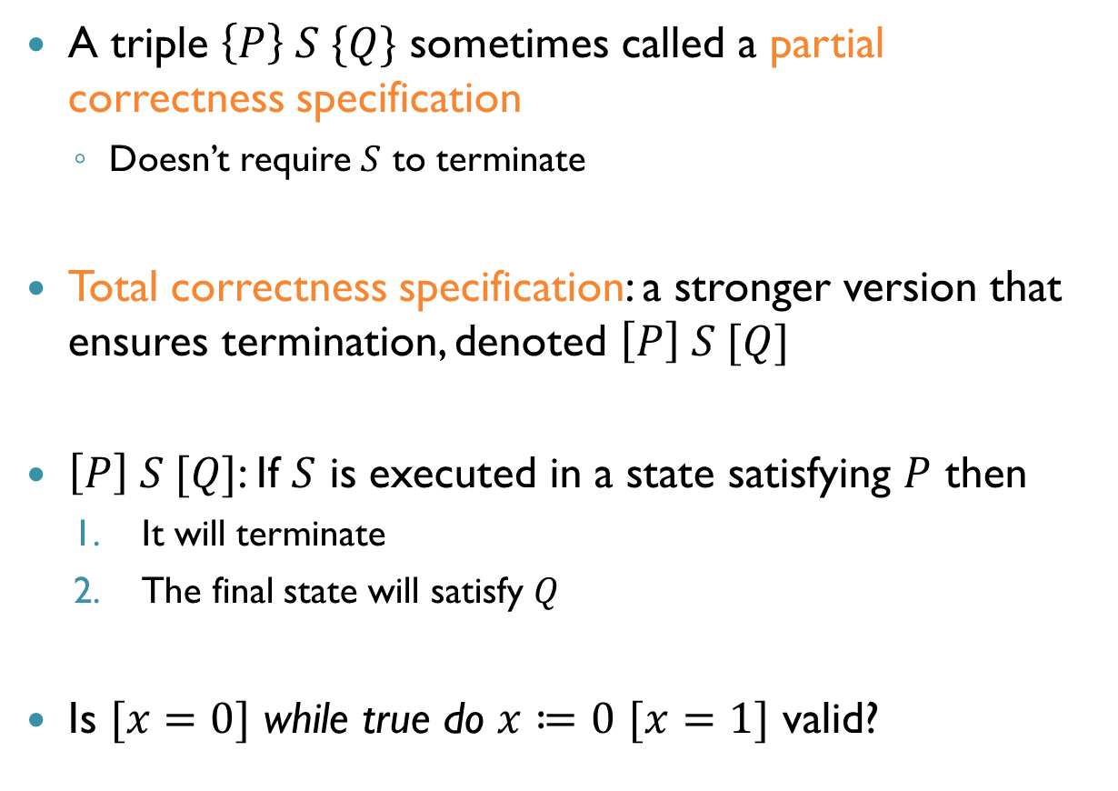
Partial and Total Correctness
A triple $\left\{P\right\} S \{Q\}$ sometimes called a partial correctness specification
Doesn’t require $S$ to terminate
Total correctness specification: a stronger version that ensures termination, denoted $\left[P\right] S [Q]$
$\left[P\right] S [Q]$: If $S$ is executed in a state satisfying $P$ then
It will terminate
The final state will satisfy $Q$
Is $[x=0]$ while true do $x≔0$ $[x=1]$ valid?
No

Slide 12
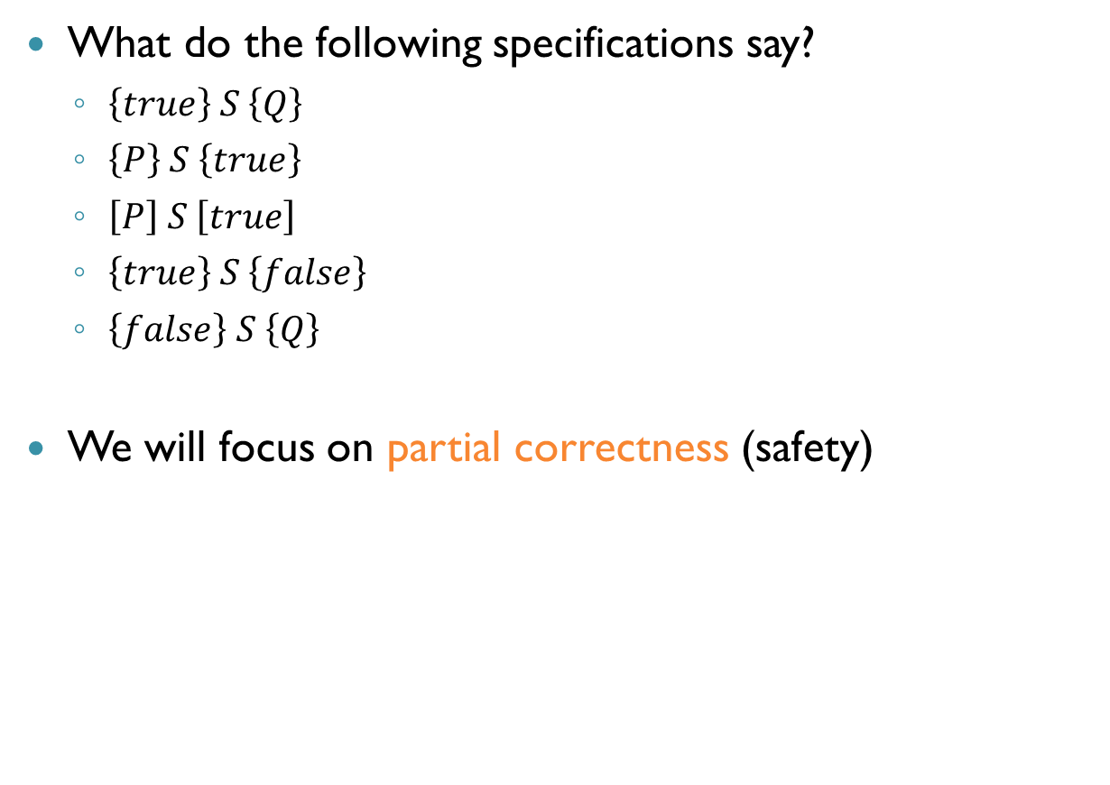
Examples
What do the following specifications say?
$\left\{true\right\} S \left\{Q\right\}$
$\left\{P\right\} S \left\{true\right\}$
$\left[P\right] S \left[true\right]$
$\left\{true\right\} S \left\{false\right\}$
$\left\{false\right\} S \left\{Q\right\}$
We will focus on partial correctness (safety)

Slide 13
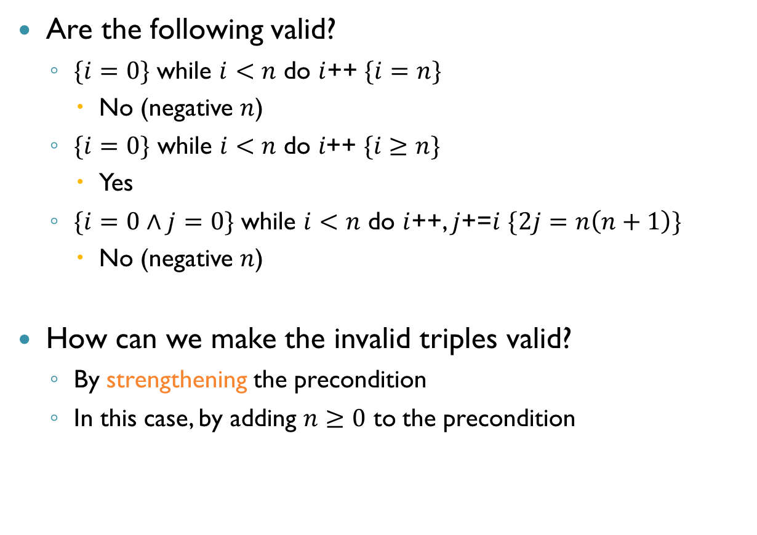
More Examples
Are the following valid?
$\{i=0\}$ while $i<n$ do $i$++ $\{i=n\}$
No (negative $n$)
$\{i=0\} \text{while} i<n \text{do} i\text{++ }\{i≥n\}$
Yes
$\{i=0∧j=0\}$ while $i<n$ do $i$++, $j$+=$i$ $\{2j=n\left(n+1\right)\}$
No (negative $n$)
How can we make the invalid triples valid?
By strengthening the precondition
In this case, by adding $n≥0$ to the precondition

Slide 14
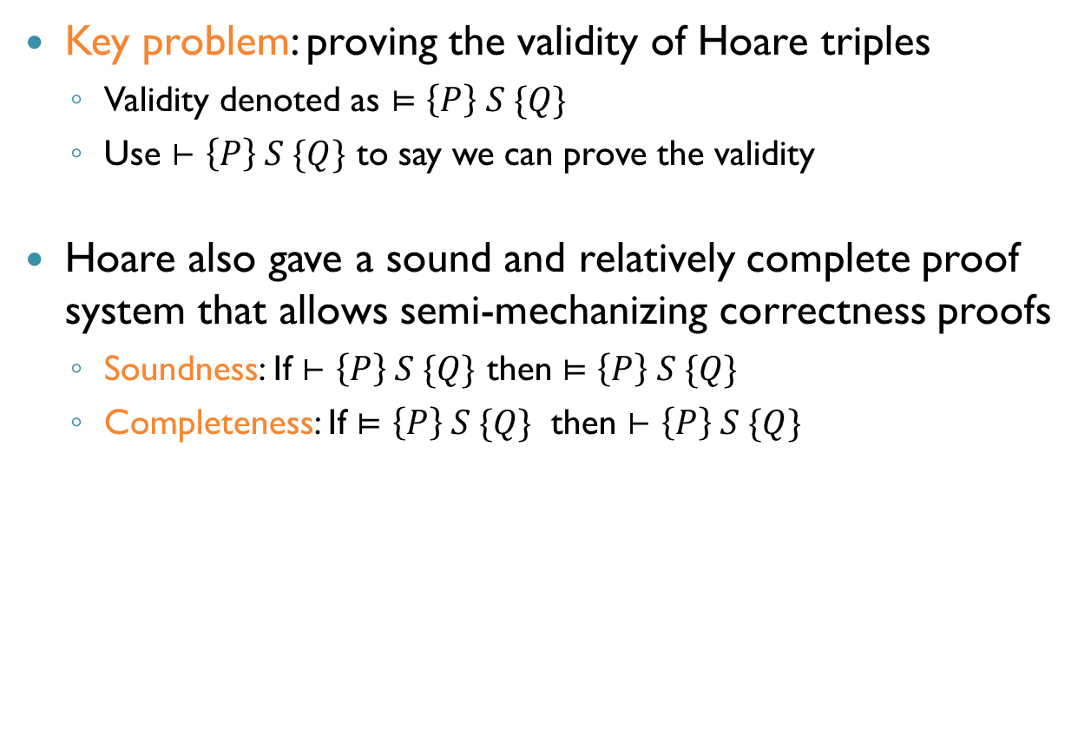
Proving Partial Correctness
Key problem: proving the validity of Hoare triples
Validity denoted as $⊨\left\{P\right\} S \{Q\}$
Use $⊢\left\{P\right\} S \{Q\}$ to say we can prove the validity
Hoare also gave a sound and relatively complete proof system that allows semi-mechanizing correctness proofs
Soundness: If $⊢\left\{P\right\} S \{Q\}$ then $⊨\left\{P\right\} S \{Q\}$
Completeness: If $⊨\left\{P\right\} S \{Q\}$ then $⊢\left\{P\right\} S \{Q\}$

Slide 15
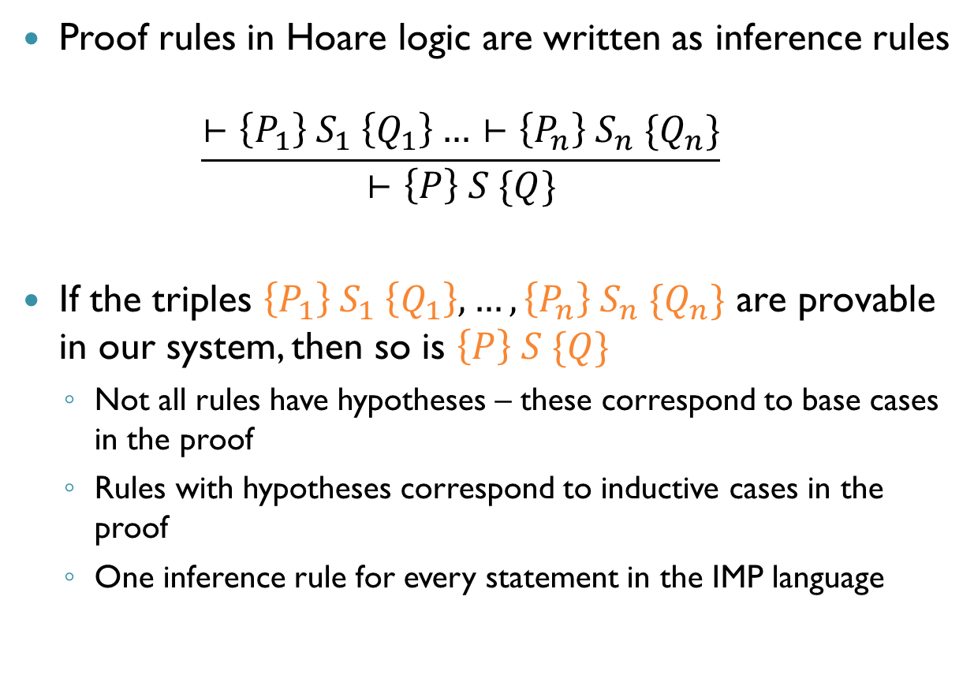
Inference Rules
Proof rules in Hoare logic are written as inference rules $\frac{⊢\left\{P_{1}\right\} S_{1} \left\{Q_{1}\right\}…⊢\left\{P_{n}\right\} S_{n} \{Q_{n}\}}{⊢\left\{P\right\} S \{Q\}}$
If the triples $\left\{P_{1}\right\} S_{1} \left\{Q_{1}\right\},…,\left\{P_{n}\right\} S_{n} \{Q_{n}\}$ are provable in our system, then so is $\left\{P\right\} S \{Q\}$
Not all rules have hypotheses – these correspond to base cases in the proof
Rules with hypotheses correspond to inductive cases in the proof
One inference rule for every statement in the IMP language

Slide 16
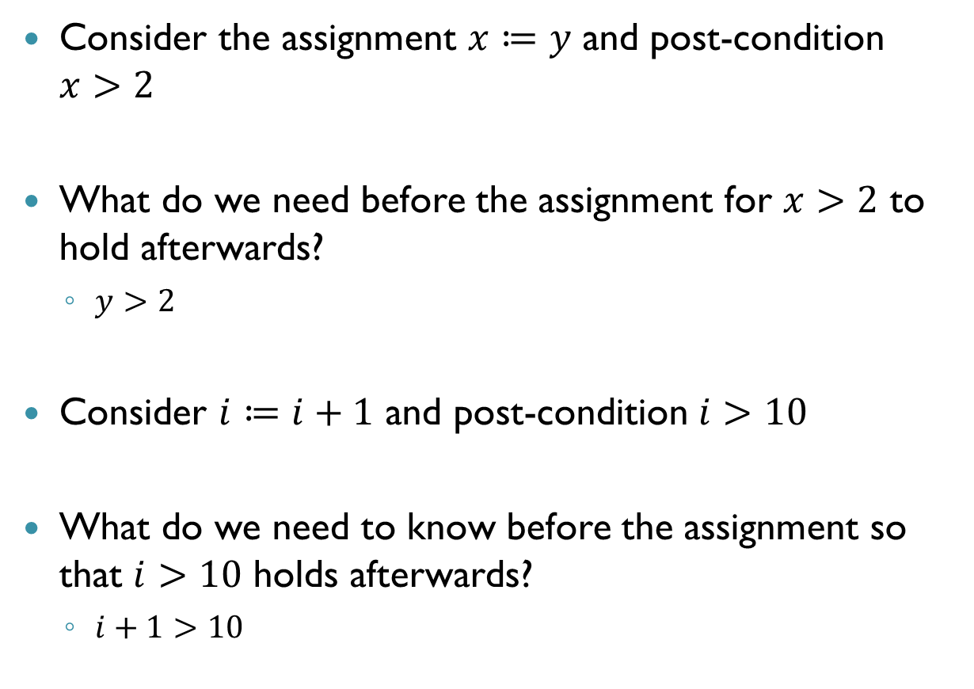
Proof Rule for Assignment
Consider the assignment $x≔y$ and post-condition $x>2$
What do we need before the assignment for $x>2$ to hold afterwards?
$y>2$
Consider $i≔i+1$ and post-condition $i>10$
What do we need to know before the assignment so that $i>10$ holds afterwards?
$i+1>10$

Slide 17
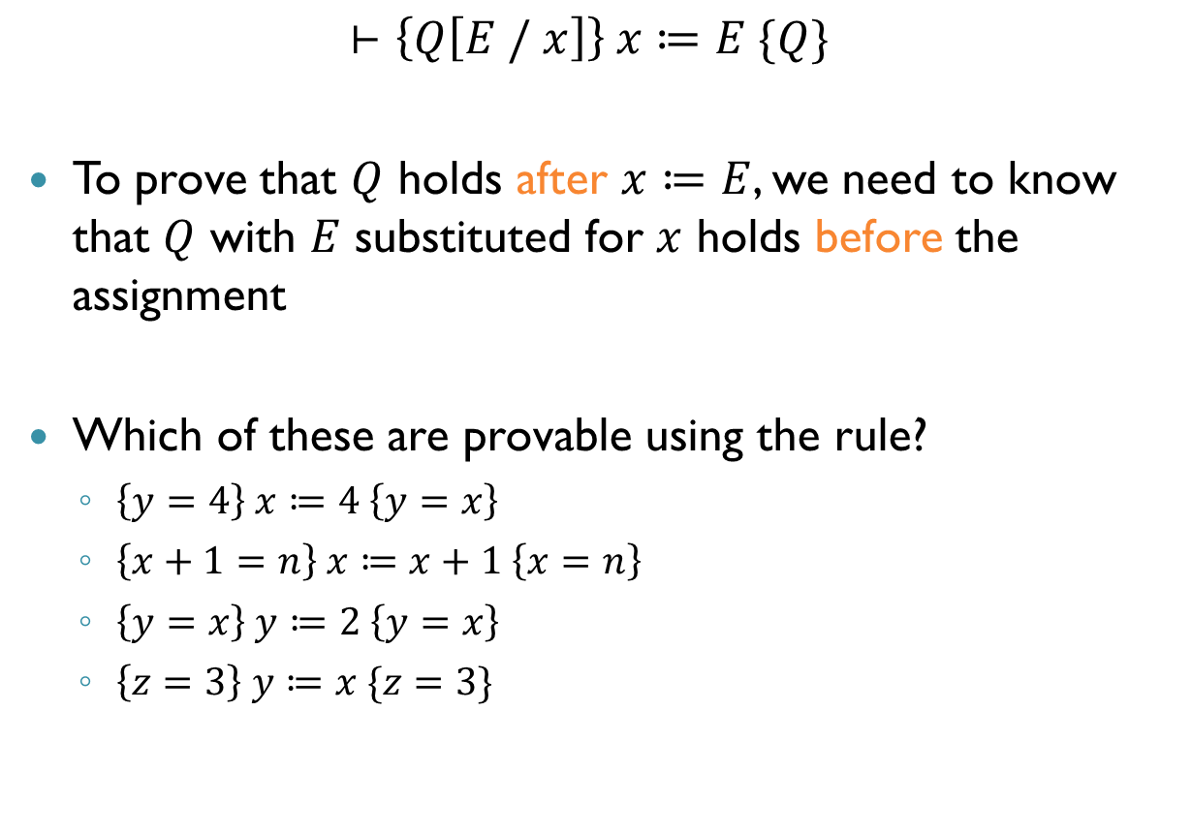
Proof Rule for Assignment (cnt’d)
$$⊢\left\{Q\left[E / x\right]\right\} x≔E \{Q\}$$
To prove that $Q$ holds after $x≔E$, we need to know that $Q$ with $E$ substituted for $x$ holds before the assignment
Which of these are provable using the rule?
$\left\{y=4\right\} x≔4 \left\{y=x\right\}$
$\left\{x+1=n\right\} x≔x+1 \left\{x=n\right\}$
$\left\{y=x\right\} y≔2 \left\{y=x\right\}$
$\left\{z=3\right\} y≔x \{z=3\}$
Yes
Yes
No
Yes

Slide 18
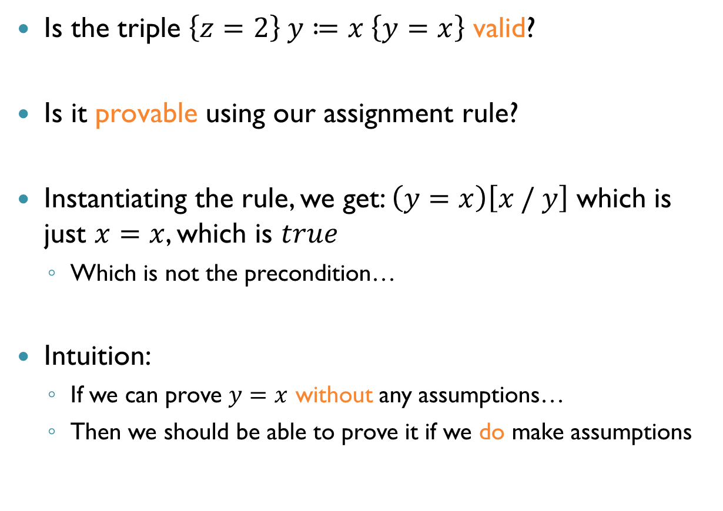
Precondition Strengthening
Is the triple $\left\{z=2\right\} y≔x \left\{y=x\right\}$ valid?
Is it provable using our assignment rule?
Instantiating the rule, we get: $\left(y=x\right)\left[x / y\right]$ which is just $x=x$, which is $true$
Which is not the precondition…
Intuition:
If we can prove $y=x$ without any assumptions…
Then we should be able to prove it if we do make assumptions

Slide 19

Proof Rule for Precondition Strengthening
$$\frac{⊢\left\{P^{′}\right\} S \left\{Q\right\} P⇒P′}{⊢\left\{P\right\} S \{Q\}}$$
But how can we know that $P⇒P′$?
An SMT solver can prove that for us!

Slide 20
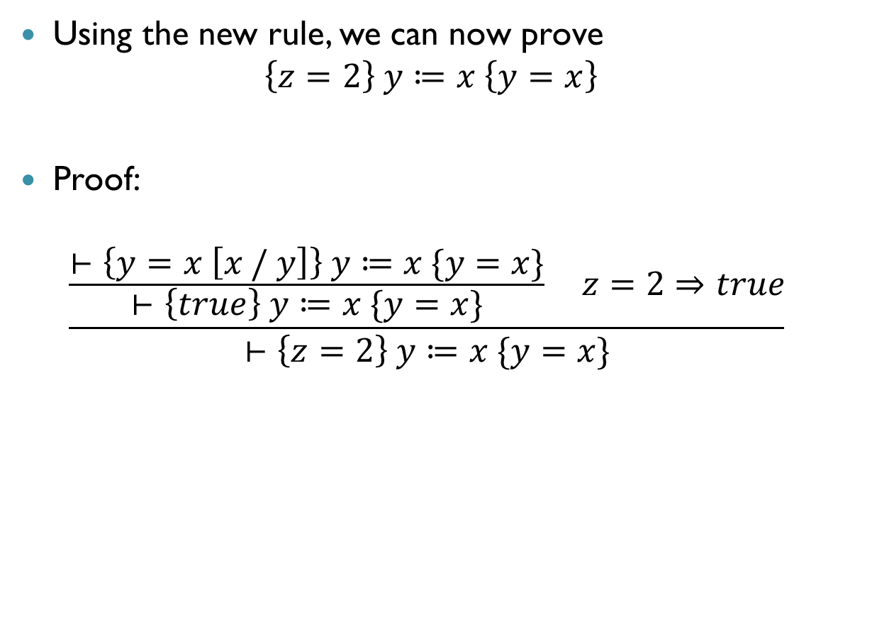
Example
Using the new rule, we can now prove $\left\{z=2\right\} y≔x \left\{y=x\right\}$
Proof:
$$\frac{\frac{⊢\left\{y=x \left[x / y\right]\right\} y≔x \{y=x\}}{⊢\left\{true\right\} y≔x \{y=x\}} z=2⇒true}{⊢\left\{z=2\right\} y≔x \{y=x\}}$$

Slide 21
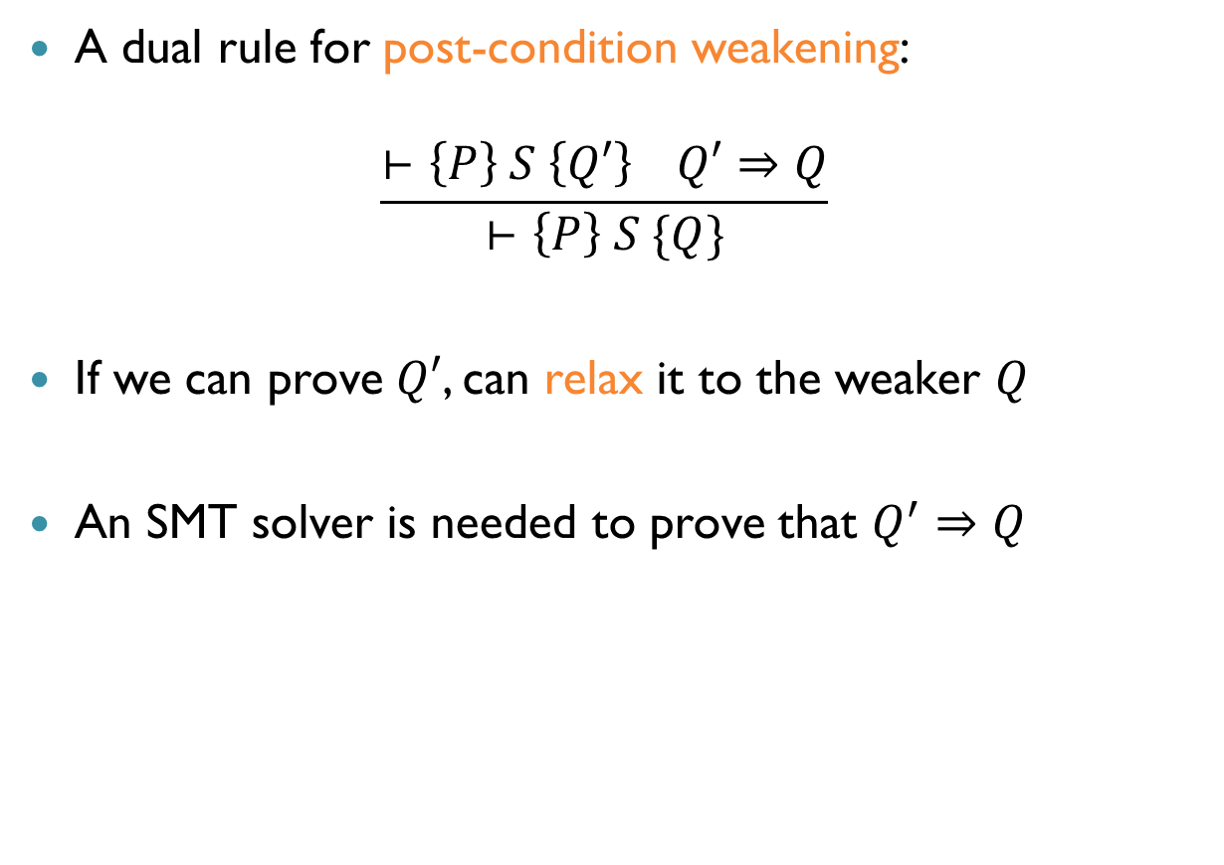
Post-Condition Weakening
A dual rule for post-condition weakening:
$$\frac{⊢\left\{P\right\} S \left\{Q′\right\} Q′⇒Q}{⊢\left\{P\right\} S \{Q\}}$$
If we can prove $Q′$, can relax it to the weaker $Q$
An SMT solver is needed to prove that $Q^{′}⇒Q$

Slide 22
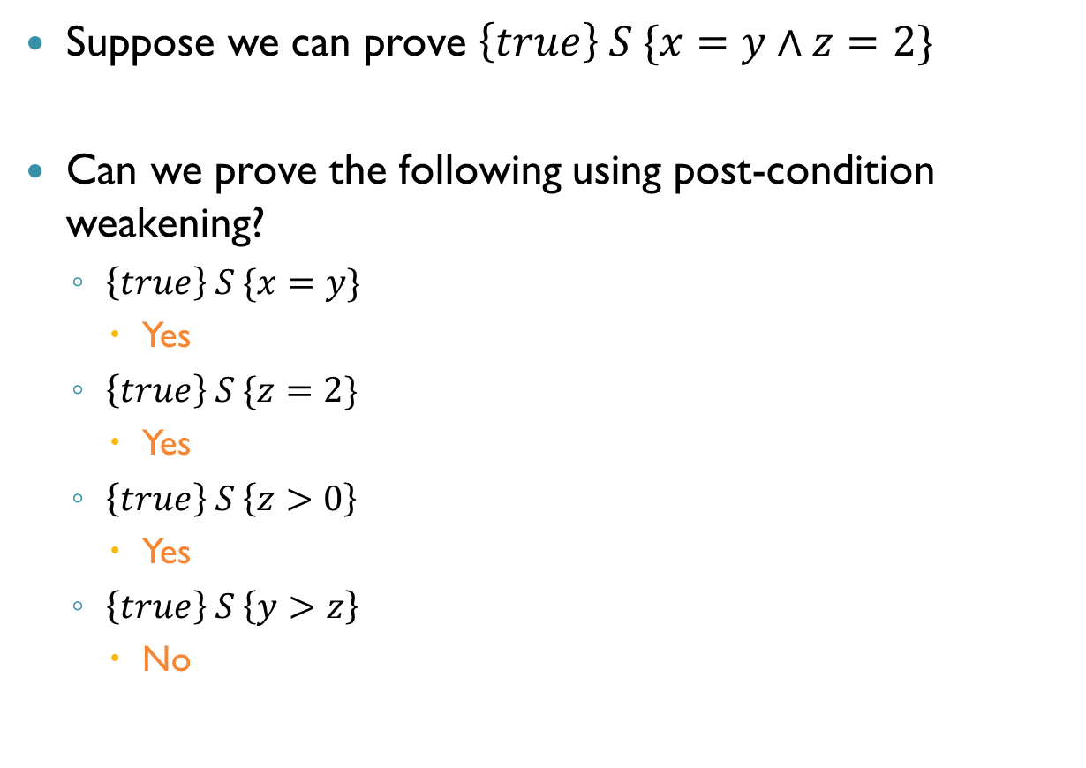
Examples
Suppose we can prove $\left\{true\right\} S \{x=y∧z=2\}$
Can we prove the following using post-condition weakening?
$\left\{true\right\} S \{x=y\}$
Yes
$\left\{true\right\} S \{z=2\}$
Yes
$\left\{true\right\} S \left\{z>0\right\}$
Yes
$\left\{true\right\} S \left\{y>z\right\}$
No

Slide 23

Proof Rule for Composition
$$\frac{⊢\left\{P\right\} S_{1} \left\{Q\right\} ⊢\left\{Q\right\} S_{2} \{R\}}{⊢\left\{P\right\} S_{1};S_{2} \{R\}}$$
Use this to prove the validity of: $\left\{true\right\} x≔2;y≔x \{y=2∧x=2\}$
What is the appropriate $Q$?
$x=2$

Slide 24

Proof Rule for Composition (cnt’d)
Use this to prove the validity of: $\left\{true\right\} x≔2;y≔x \{y=2∧x=2\}$
$$\frac{\frac{\left\{x=2 \left[2 / x\right]\right\} x≔2 \{x=2\}}{\left\{true\right\} x≔2 \{x=2\}} \frac{\left\{x=2∧y=2 \left[x / y\right]\right\} y≔x \{x=2∧y=2\}}{\left\{x=2\right\} y≔x \{x=2∧y=2\}}}{⊢\left\{true\right\} x≔2;y≔x \{y=2∧x=2\}}$$

Slide 25

Proof Rule for If Statements
$$\frac{\begin{matrix}⊢\left\{P∧C\right\} S_{1} \left\{Q\right\} \\ ⊢\left\{P∧¬C\right\} S_{2} \left\{Q\right\}\end{matrix}}{⊢\left\{P\right\} if C then S_{1} else S_{2} \{Q\}}$$
Then branch: know $P∧C$, prove $Q$
Else branch: known $P∧¬C$, prove $Q$

Slide 26
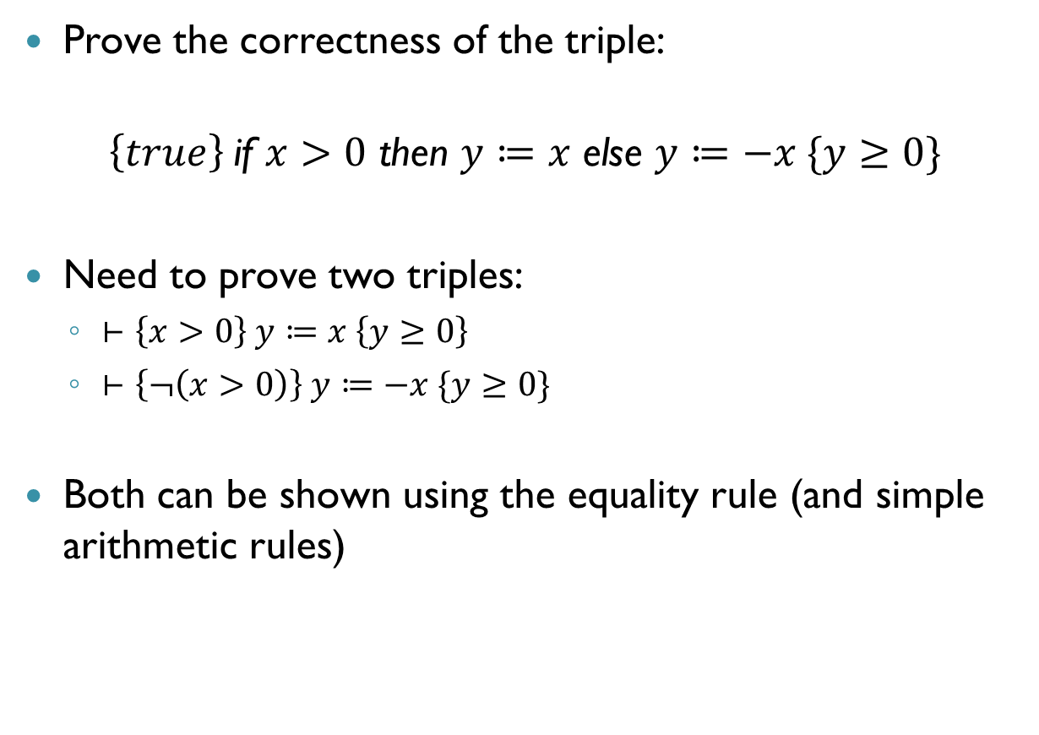
Proof Rule for If Statements (cnt’d)
Prove the correctness of the triple:
$\left\{true\right\}$if $x>0$ then $y≔x$ else $y≔−x \{y≥0\}$
Need to prove two triples:
$⊢\left\{x>0\right\} y≔x \left\{y≥0\right\}$
$⊢\left\{¬\left(x>0\right)\right\} y≔−x \{y≥0\}$
Both can be shown using the equality rule (and simple arithmetic rules)

Slide 27
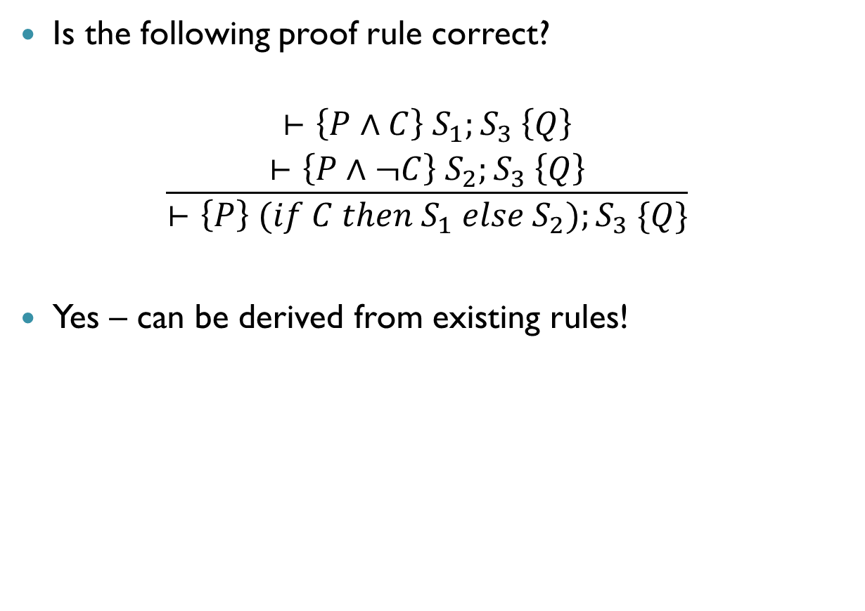
Exercise
Is the following proof rule correct?
$$\frac{\begin{matrix}⊢\left\{P∧C\right\} S_{1};S_{3} \left\{Q\right\} \\ ⊢\left\{P∧¬C\right\} S_{2};S_{3} \left\{Q\right\}\end{matrix}}{⊢\left\{P\right\} (if C then S_{1} else S_{2});S_{3} \{Q\}}$$
Yes – can be derived from existing rules!

Slide 28
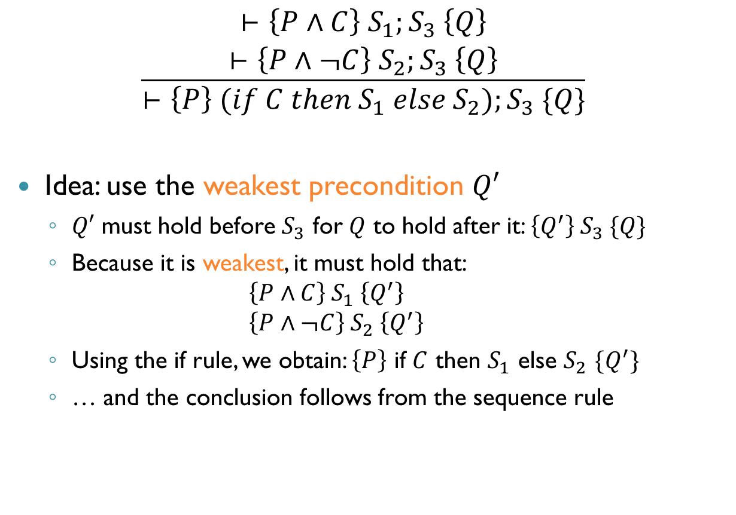
Exercise (cnt’d)
$$\frac{\begin{matrix}⊢\left\{P∧C\right\} S_{1};S_{3} \left\{Q\right\} \\ ⊢\left\{P∧¬C\right\} S_{2};S_{3} \left\{Q\right\}\end{matrix}}{⊢\left\{P\right\} (if C then S_{1} else S_{2});S_{3} \{Q\}}$$
Idea: use the weakest precondition $Q′$
$Q′$ must hold before $S_{3}$ for $Q$ to hold after it: $\left\{Q^{′}\right\} S_{3} \{Q\}$
Because it is weakest, it must hold that: $\left\{P∧C\right\} S_{1} \left\{Q^{′}\right\}$ $\left\{P∧¬C\right\} S_{2} \left\{Q^{′}\right\}$
Using the if rule, we obtain: $\left\{P\right\}$ if $C$ then $S_{1}$ else $S_{2}$ $\{Q^{′}\}$
… and the conclusion follows from the sequence rule

Slide 29
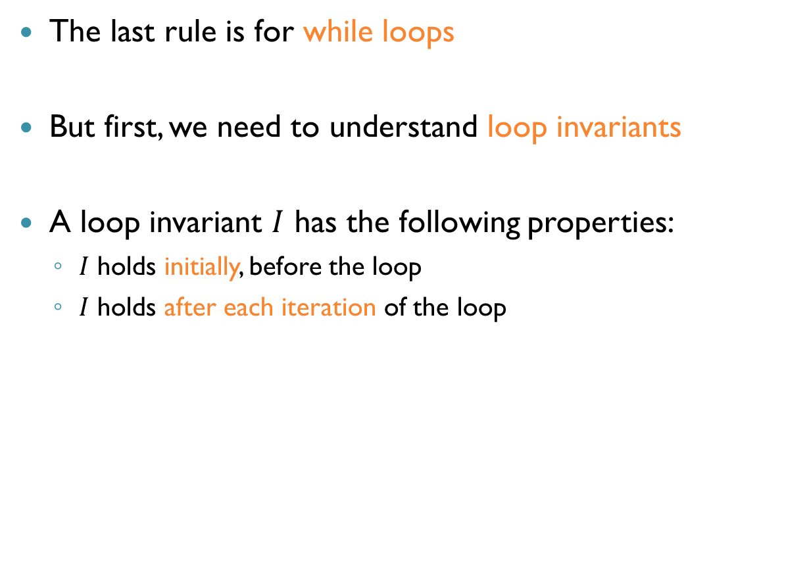
Proof Rule for While Loops
The last rule is for while loops
But first, we need to understand loop invariants
A loop invariant $I$ has the following properties:
$I$ holds initially, before the loop
$I$ holds after each iteration of the loop

Slide 30
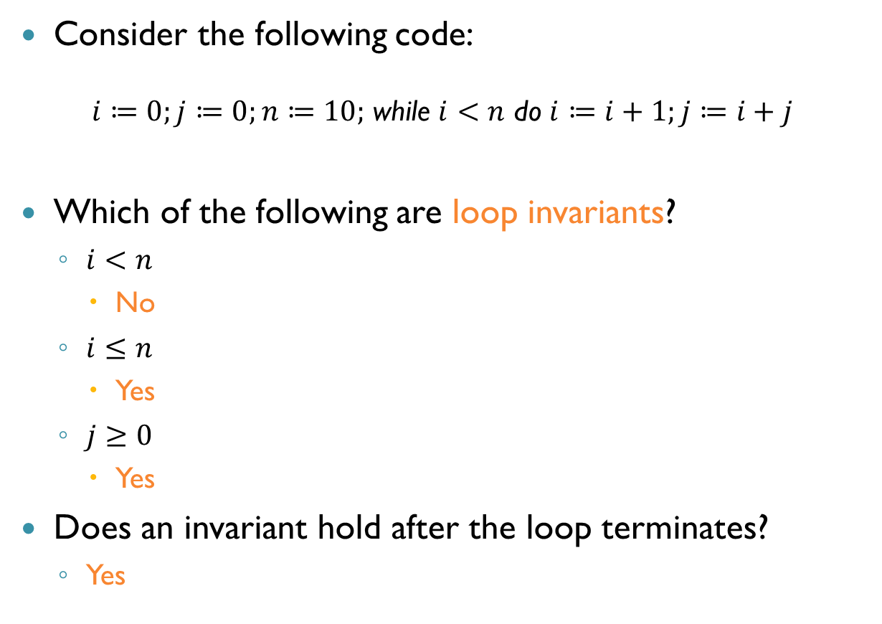
Examples
Consider the following code:
$i≔0;j≔0;n≔10;$ while $i<n$ do $i≔i+1;j≔i+j$
Which of the following are loop invariants?
$i<n$
No
$i≤n$
Yes
$j≥0$
Yes
Does an invariant hold after the loop terminates?
Yes

Slide 31
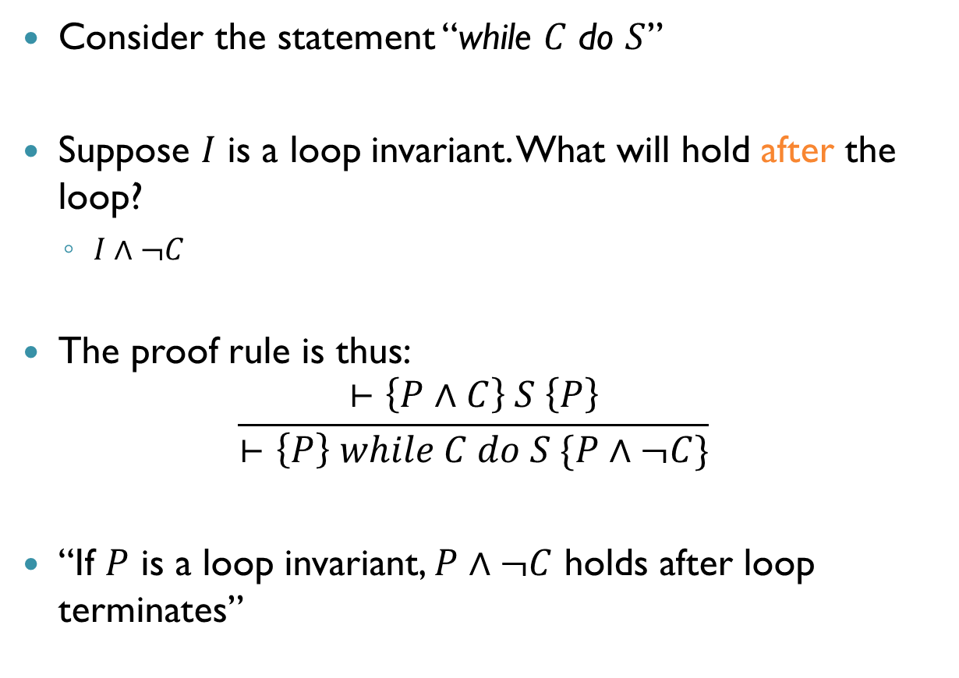
Proof Rule for While
Consider the statement “while $C$ do $S$”
Suppose $I$ is a loop invariant. What will hold after the loop?
$I∧¬C$
The proof rule is thus:
$$\frac{⊢\left\{P∧C\right\} S \left\{P\right\}}{⊢\left\{P\right\} while C do S \{P∧¬C\}}$$
“If $P$ is a loop invariant, $P∧¬C$ holds after loop terminates”

Slide 32
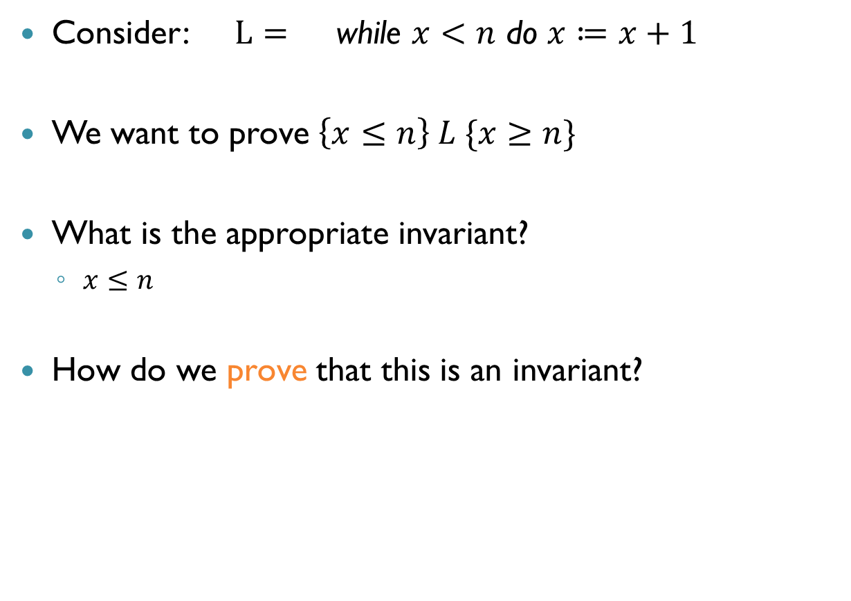
Example
Consider: $L=$ while $x<n$ do $x≔x+1$
We want to prove $\left\{x≤n\right\} L \{x≥n\}$
What is the appropriate invariant?
$x≤n$
How do we prove that this is an invariant?

Slide 33

Example (cnt’d)
$L=$ while $x<n$ do $x≔x+1$ $P= x≤n$ $C= x<n$ $S= x≔x+1$
Need to prove: $\left\{P∧C\right\} S \{P\}$
$$\frac{x≤n∧x<n⇒x+1≤n \left\{x≤n\left[x+1 / x\right]\right\} x≔x+1 \left\{x≤n\right\}}{\left\{x≤n∧x<n\right\} x≔x+1 \{x≤n\}}$$

Slide 34
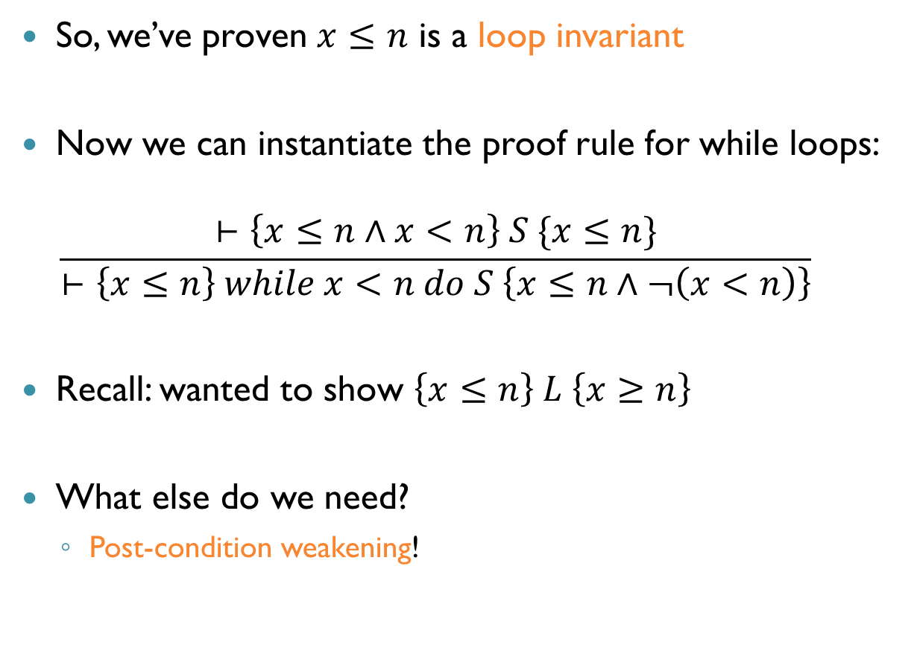
Example (cnt’d)
So, we’ve proven $x≤n$ is a loop invariant
Now we can instantiate the proof rule for while loops: $\frac{⊢\left\{x≤n∧x<n\right\} S \{x≤n\}}{⊢\left\{x≤n\right\} while x<n do S \left\{x≤n∧¬\left(x<n\right)\right\}}$
Recall: wanted to show $\left\{x≤n\right\} L \left\{x≥n\right\}$
What else do we need?
Post-condition weakening!

Slide 35

Example (cnt’d)
The full proof:
$$\frac{\frac{\frac{\begin{aligned}\left\{x+1≤n\right\} x≔x+1 \{x≤n\} \\ x≤n∧x<n⇒x+1<n\end{aligned}}{\left\{x≤n∧x<n\right\} x≔x+1 \{x≤n\}}}{\left\{x≤n\right\} L \{x≤n∧¬\left(x<n\right)\}} x≤n∧¬\left(x<n\right)⇒x≥n}{\left\{x≤n\right\} L \{x≥n\}}$$

Slide 36
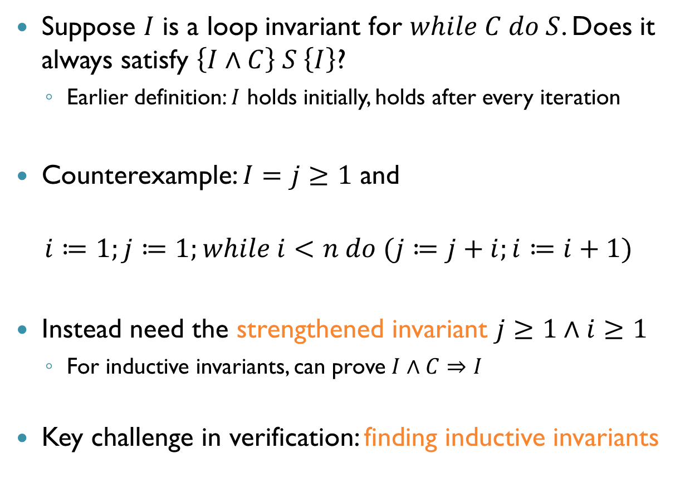
Invariants and Inductive Invariants
Suppose $I$ is a loop invariant for $while C do S$. Does it always satisfy $\left\{I∧C\right\} S \left\{I\right\}$?
Earlier definition: $I$ holds initially, holds after every iteration
Counterexample: $I=j≥1$ and
$$i≔1;j≔1;while i<n do (j≔j+i;i≔i+1)$$
Instead need the strengthened invariant $j≥1∧i≥1$
For inductive invariants, can prove $I∧C⇒I$
Key challenge in verification: finding inductive invariants

Slide 37
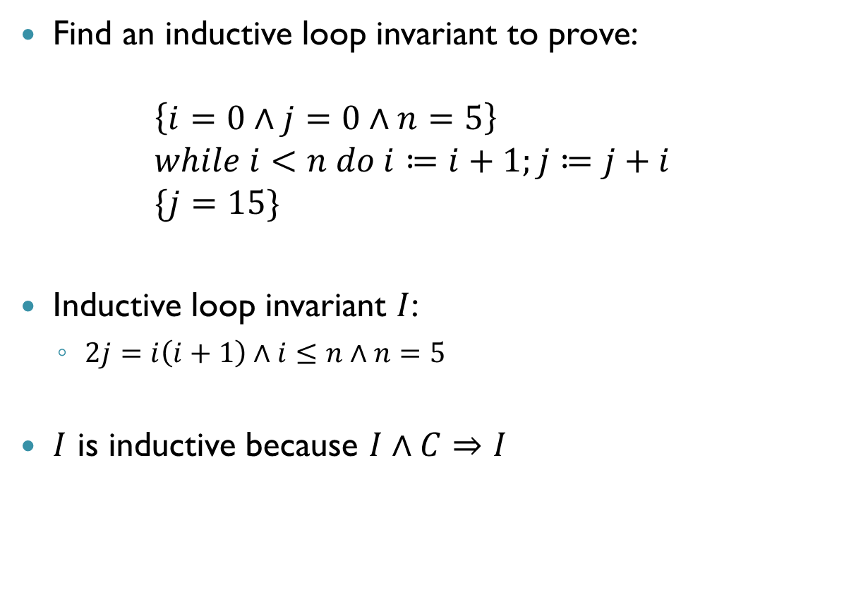
Exercise
Find an inductive loop invariant to prove: $\left\{i=0∧j=0∧n=5\right\}$ $while i<n do i≔i+1;j≔j+i$ $\{j=15\}$
Inductive loop invariant $I$:
$2j=i\left(i+1\right)∧i≤n∧n=5$
$I$ is inductive because $I∧C⇒I$

Slide 38
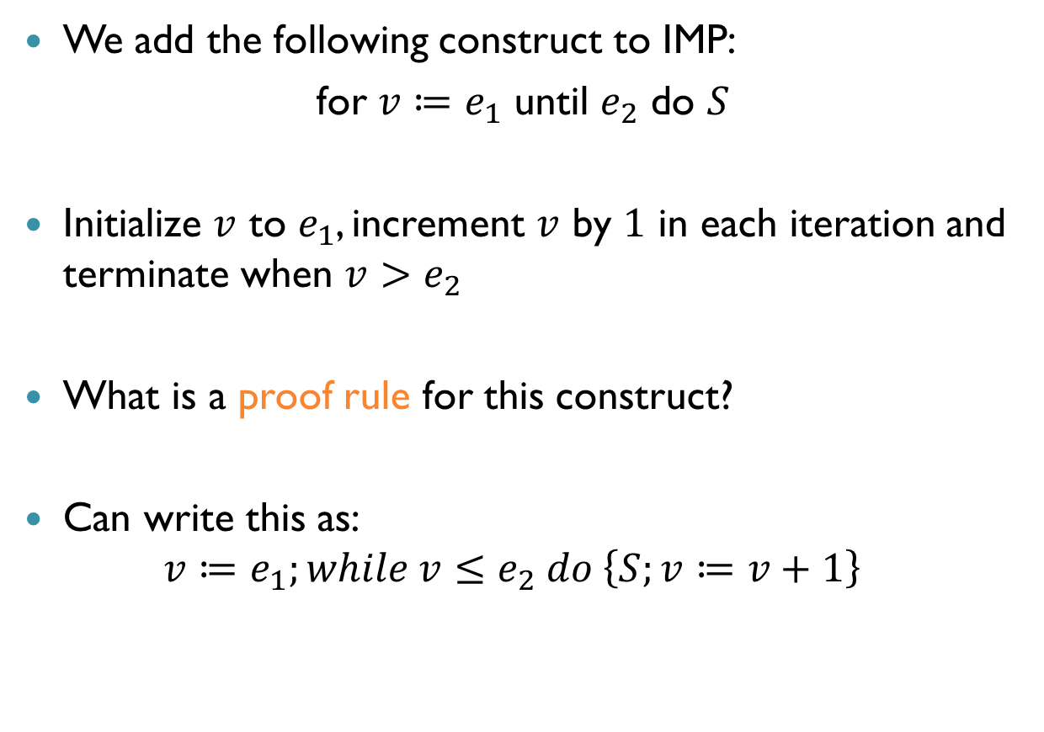
Another Exercise
We add the following construct to IMP:
for $v≔e_{1}$ until $e_{2}$ do $S$
Initialize $v$ to $e_{1}$, increment $v$ by $1$ in each iteration and terminate when $v>e_{2}$
What is a proof rule for this construct?
Can write this as: $v≔e_{1};while v≤e_{2} do \left\{S;v≔v+1\right\}$

Slide 39
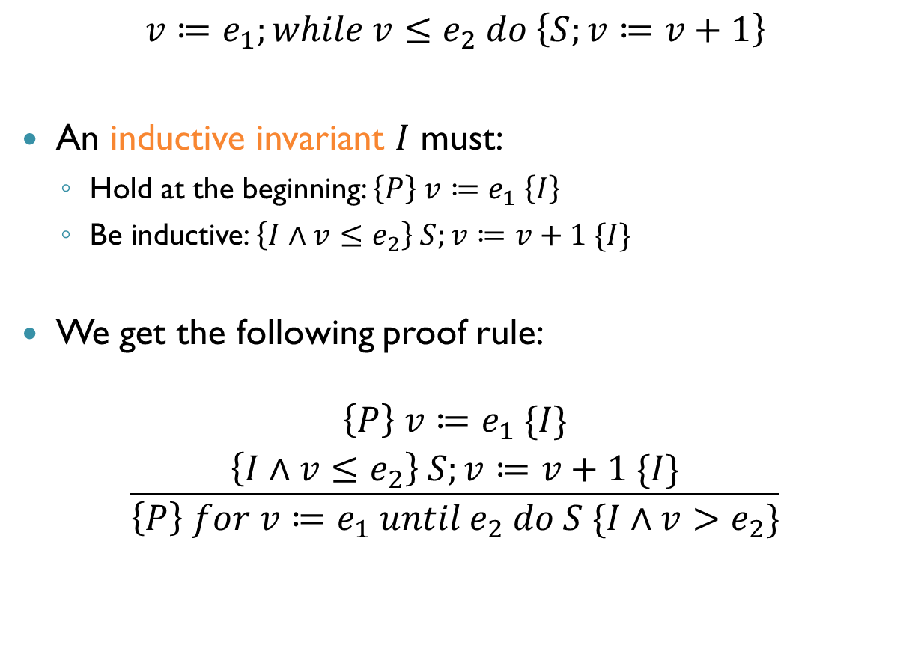
Another Exercise (cnt’d)
$$v≔e_{1};while v≤e_{2} do \left\{S;v≔v+1\right\}$$
An inductive invariant $I$ must:
Hold at the beginning: $\left\{P\right\} v≔e_{1} \left\{I\right\}$
Be inductive: $\left\{I∧v≤e_{2}\right\} S;v≔v+1 \{I\}$
We get the following proof rule:
$$\frac{\begin{aligned}\left\{P\right\} v≔e_{1} \{I\} \\ \left\{I∧v≤e_{2}\right\} S;v≔v+1 \{I\}\end{aligned}}{\left\{P\right\} for v≔e_{1} until e_{2} do S \{I∧v>e_{2}\}}$$

Slide 40

Summary of Proof Rules
Assignment: $⊢\left\{Q\left[E / x\right]\right\} x=E \{Q\}$
Strengthen P: $\frac{⊢\left\{P^{′}\right\} S \left\{Q\right\} P⇒P^{′}}{⊢\left\{P\right\} S \{Q\}}$
Weaken Q: $\frac{⊢\left\{P\right\} S \left\{Q^{′}\right\} Q^{′}⇒Q}{⊢\left\{P\right\} S \{Q\}}$
Composition: $\frac{⊢\left\{P\right\}{ C}_{1} \left\{Q\right\} ⊢\left\{Q\right\} C_{2} \left\{R\right\}}{⊢\left\{P\right\}{ C}_{1};C_{2} \left\{R\right\}}$
If: $\frac{\begin{aligned}⊢\left\{P∧C\right\} S_{1} \{Q\} \\ ⊢\left\{P∧¬C\right\} S_{2} \left\{Q\right\}\end{aligned}}{⊢\left\{P\right\} if C then S_{1} else S_{2} \left\{Q\right\}}$
While: $\frac{⊢\left\{P∧C\right\} S \left\{P\right\}}{⊢\left\{P\right\} while C do S \left\{P∧¬C\right\}}$

Slide 41
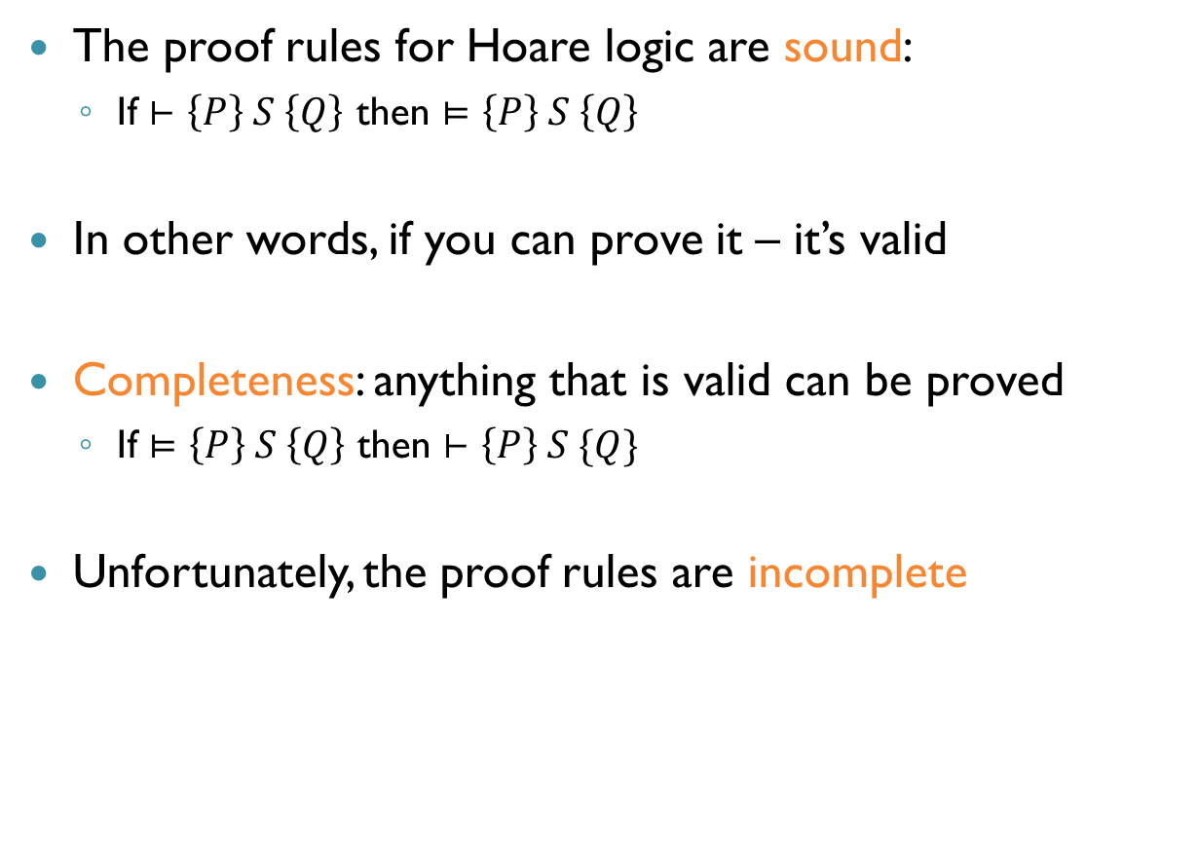
Soundness and Completeness
The proof rules for Hoare logic are sound:
If $⊢\left\{P\right\} S \left\{Q\right\}$ then $⊨\left\{P\right\} S \left\{Q\right\}$
In other words, if you can prove it – it’s valid
Completeness: anything that is valid can be proved
If $⊨\left\{P\right\} S \left\{Q\right\}$ then $⊢\left\{P\right\} S \{Q\}$
Unfortunately, the proof rules are incomplete

Slide 42
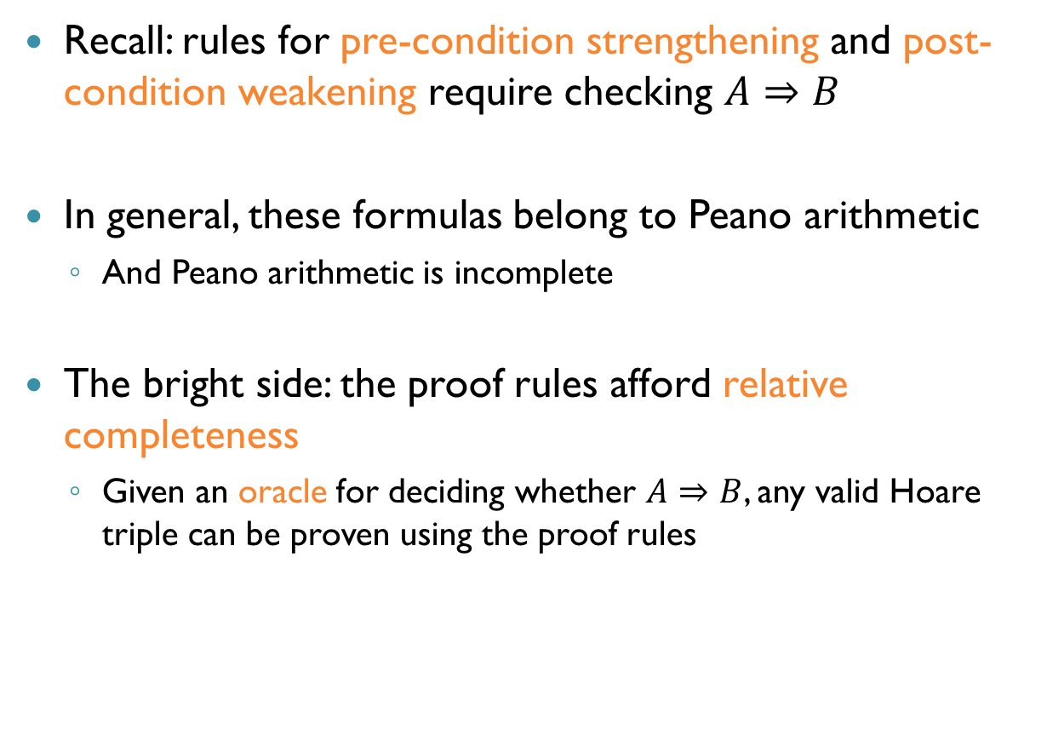
Relative Completeness
Recall: rules for pre-condition strengthening and post-condition weakening require checking $A⇒B$
In general, these formulas belong to Peano arithmetic
And Peano arithmetic is incomplete
The bright side: the proof rules afford relative completeness
Given an oracle for deciding whether $A⇒B$, any valid Hoare triple can be proven using the proof rules

Slide 43
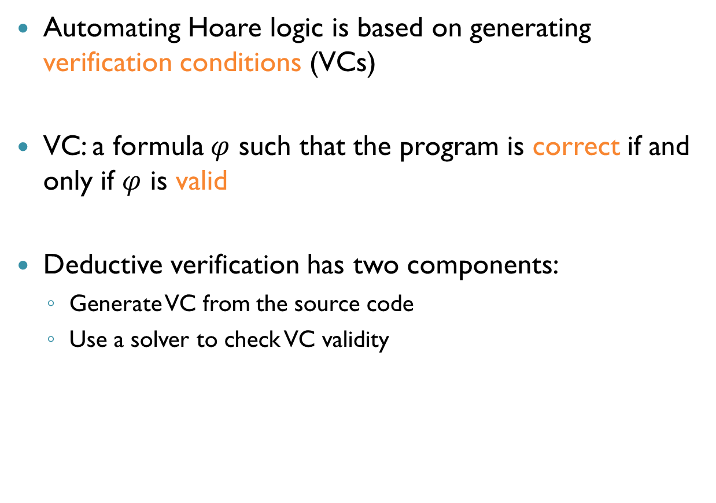
Program Verification
Automating Hoare logic is based on generating verification conditions (VCs)
VC: a formula $φ$ such that the program is correct if and only if $φ$ is valid
Deductive verification has two components:
Generate VC from the source code
Use a solver to check VC validity

Slide 44
Generating VCs
Two general approaches: forward or backward generation
Forward analysis: start from pre-condition, generate formulas to prove post-condition
This computes the strongest post-condition (sp)
Backward analysis: start from post-condition, try to prove pre-condition
This computes the weakest pre-condition (wp)
We’ll focus on backward analysis

Slide 45
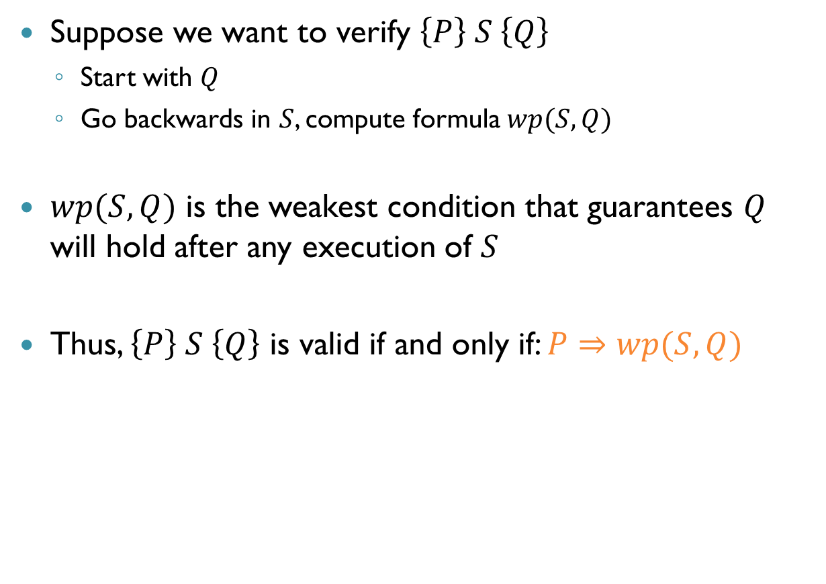
Weakest Preconditions
Suppose we want to verify $\left\{P\right\} S \left\{Q\right\}$
Start with $Q$
Go backwards in $S$, compute formula $wp(S,Q)$
$wp(S,Q)$ is the weakest condition that guarantees $Q$ will hold after any execution of $S$
Thus, $\left\{P\right\} S \left\{Q\right\}$ is valid if and only if: $P⇒wp(S,Q)$

Slide 46
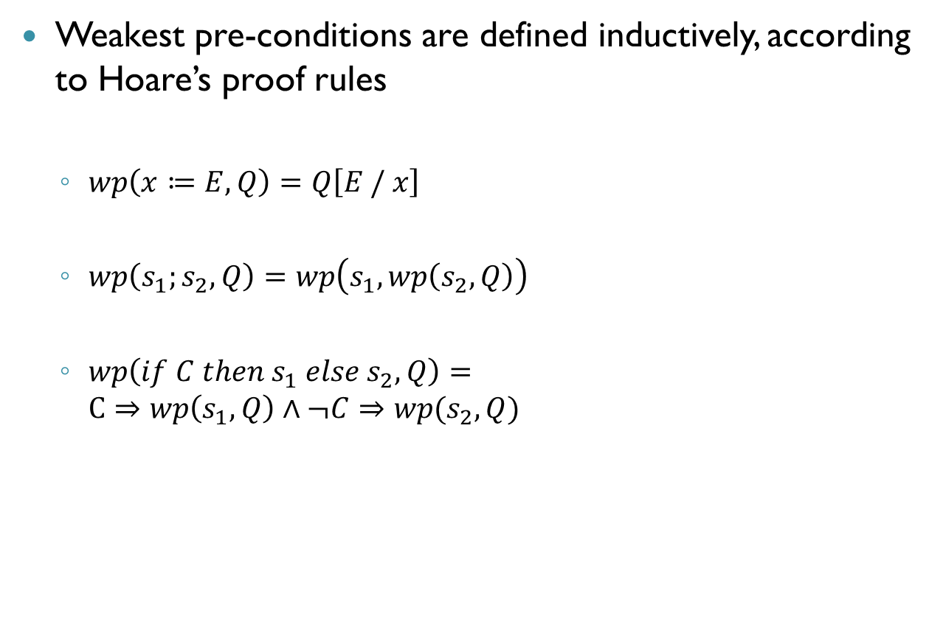
Defining Weakest Preconditions
Weakest pre-conditions are defined inductively, according to Hoare’s proof rules
$wp\left(x≔E,Q\right)=Q\left[E / x\right]$
$wp\left(s_{1};s_{2},Q\right)=wp\left(s_{1},wp\left(s_{2},Q\right)\right)$
$wp\left(if C then s_{1} else s_{2},Q\right)=$ $C⇒wp\left(s_{1},Q\right)∧¬C⇒wp(s_{2},Q)$

Slide 47
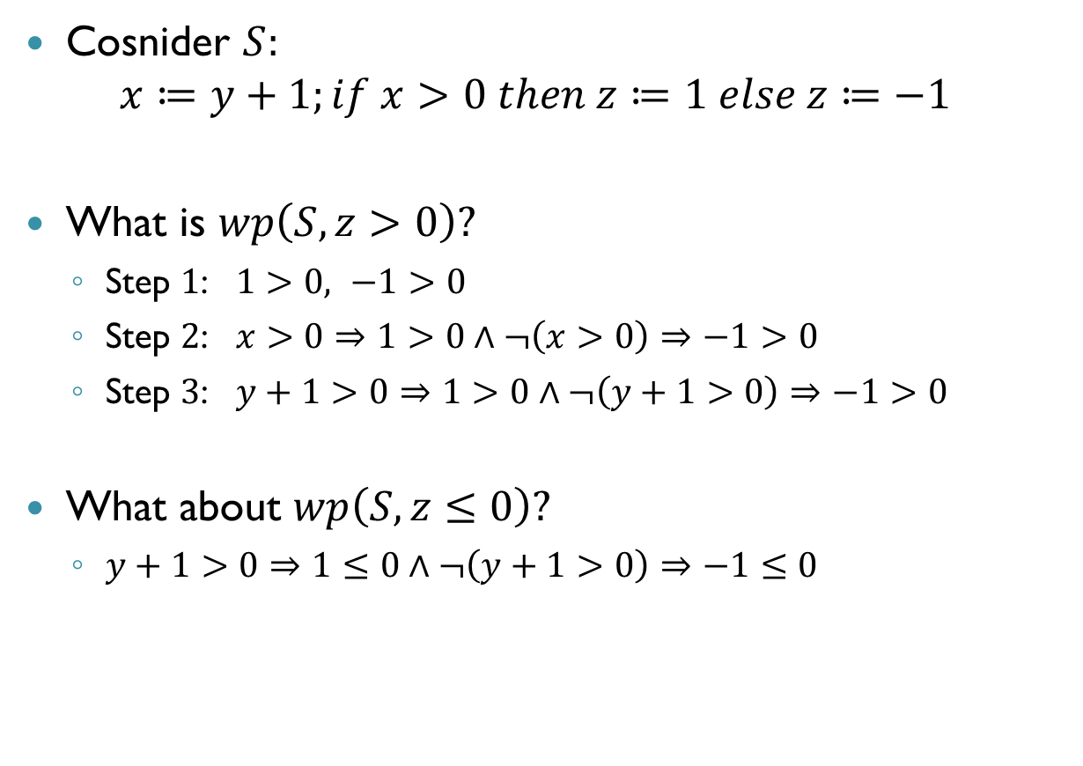
Example
Cosnider $S:$ $x≔y+1;if x>0 then z≔1 else z≔−1$
What is $wp\left(S,z>0\right)?$
Step $1$: $1>0, −1>0$
Step $2$: $x>0⇒1>0∧¬\left(x>0\right)⇒−1>0$
Step $3$: $y+1>0⇒1>0∧¬\left(y+1>0\right)⇒−1>0$
What about $wp\left(S,z≤0\right)?$
$y+1>0⇒1≤0∧¬\left(y+1>0\right)⇒−1≤0$

Slide 48
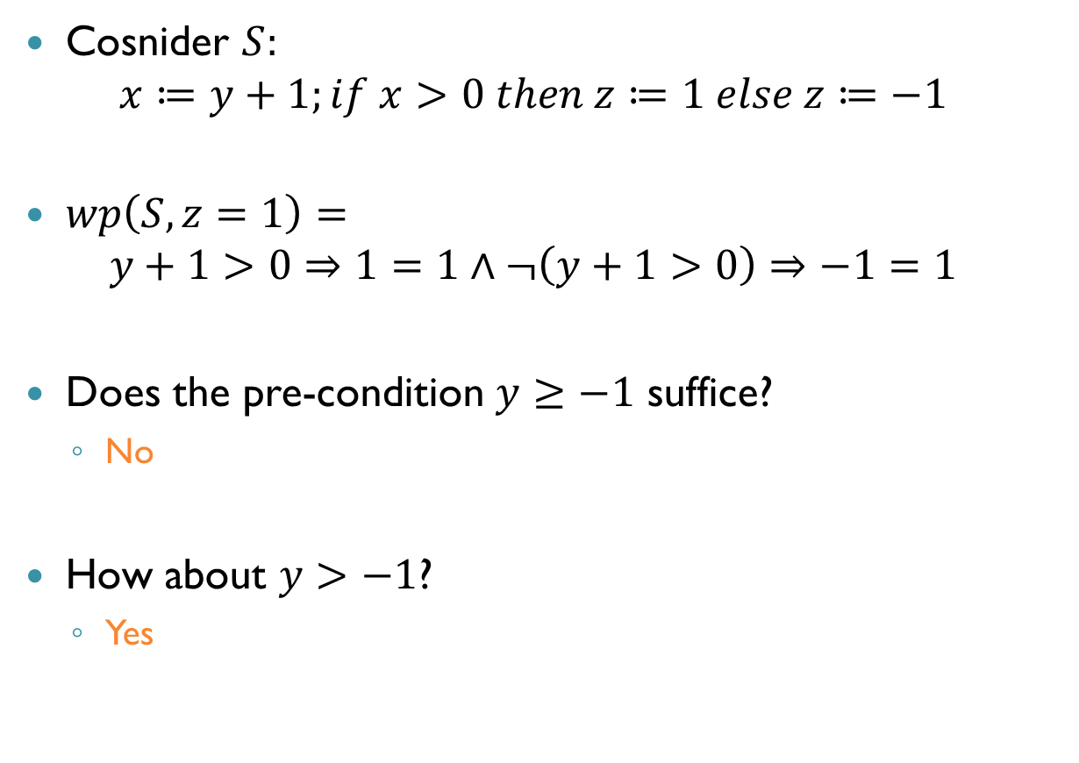
Example
Cosnider $S:$ $x≔y+1;if x>0 then z≔1 else z≔−1$
$wp\left(S,z=1\right)=$ $y+1>0⇒1=1∧¬\left(y+1>0\right)⇒−1=1$
Does the pre-condition $y≥−1$ suffice?
No
How about $y>−1$?
Yes

Slide 49
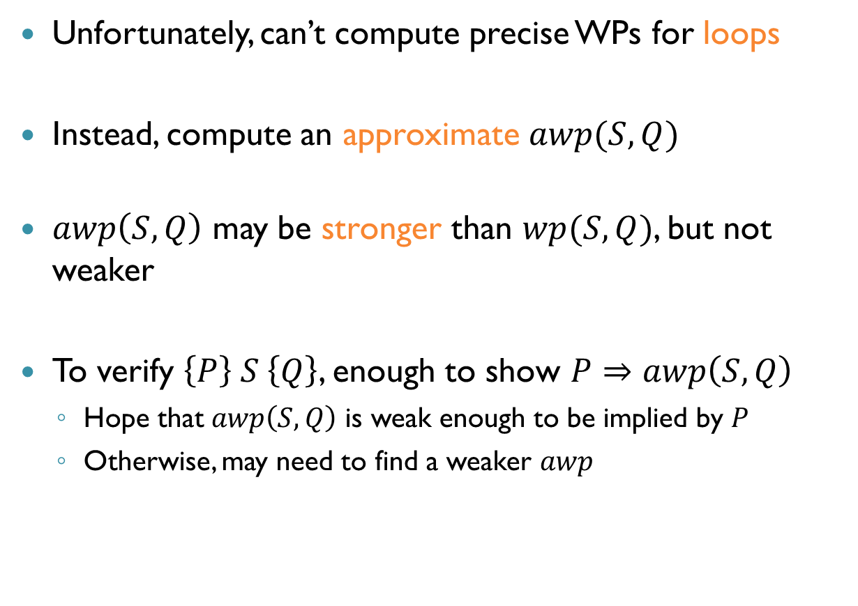
Weakest Pre-Conditions for Loops
Unfortunately, can’t compute precise WPs for loops
Instead, compute an approximate $awp(S,Q)$
$awp\left(S,Q\right)$ may be stronger than $wp(S,Q)$, but not weaker
To verify $\left\{P\right\} S \left\{Q\right\}$, enough to show $P⇒awp\left(S,Q\right)$
Hope that $awp\left(S,Q\right)$ is weak enough to be implied by $P$
Otherwise, may need to find a weaker $awp$

Slide 50

Approximate WPs for Loops
For all statements except while loops:
$awp(S,Q)$ is just $wp\left(S,Q\right)$
For loops, computing $awp(S,Q)$ relies on the loop invariant provided by the oracle
Assume all loops are annotated: while $C$ do $\left[I\right] S$
Now, define $awp\left(while C do \left[I\right] S,Q\right)=I$

Slide 51

Approximate WPs for Loops (cnt’d)
If $P⇒awp(S,Q)$, does this mean $\left\{P\right\} S \left\{Q\right\}$ is valid?
No! Two problems with $awp\left(while C do \left[I\right] S,Q\right)$:
We haven’t checked that $I$ is an actual loop invariant
We haven’t checked that $I∧¬C$ implies $Q$
So, for each while loop we generate verification conditions that encode these additional facts

Slide 52

Generating Verification Conditions
How do we handle loops?
$$VC\left(while C do \left[I\right] S,Q\right)= ?$$
To ensure that $Q$ holds after the loop…
$I∧¬C⇒Q$
To ensure that $I$ is a loop invariant…
$\left\{I∧C\right\} S \left\{I\right\}$
In other words: $I∧C⇒awp\left(S,I\right)∧VC\left(S,I\right)$
Finally: $VC\left(L,Q\right)=\left(I∧C⇒awp\left(S,I\right)∧VC\left(S,I\right)\right)∧\left(I∧¬C⇒Q\right)$

Slide 53

Other Statements
Do we need VCs also for other statements?
Yes, because their may be loops nested inside
$VC\left(x≔E,Q\right)$
$true$
$VC\left(s_{1};s_{2},Q\right)$
$VC\left(s_{2},Q\right)∧VC\left(s_{1},awp\left(s_{2},Q\right)\right)$
$VC\left(if C then s_{1} else s_{2},Q\right)$
$VC\left(s_{1},Q\right)∧VC\left(s_{2},Q\right)$

Slide 54

Verification of Hoare Triples
To show that $\left\{P\right\} S \left\{Q\right\}$ is valid, we can:
Compute $awp\left(S,Q\right)$
Compute $VC\left(S,Q\right)$
Show that $VC\left(S,Q\right)∧P⇒awp\left(S,Q\right)$ is valid
And what if $VC\left(S,Q\right)∧P⇒awp\left(S,Q\right)$ is not valid?
Hoare triple may still be valid!
Reasons: loop invariants not strong enough
So, we might not be able to prove correctness even if program is correct

Slide 55


Example
Consider the following code:
For post-condition $\{sum≥0\}$, what are the VCs and awp?
$i≔1;sum≔0$
$while i≤n$ do $\left[sum≥0\right] \{$
$j≔1$
$while j≤i do \left[sum≥0∧j≥0\right]$
$sum≔sum+j;j≔j+1$
$i≔i+1$
}

Slide 56


Example
$i≔1;sum≔0$
$while i≤n$ do $\left[sum≥0\right] \{$
$j≔1$
$while j≤i do \left[sum≥0∧j≥0\right]$
$sum≔sum+j;j≔j+1$
$i≔i+1$
}
Generate VCs for inner loop:
$\left(sum≥0∧j≥0∧j>i\right)⇒sum≥0$
$\left(j≤i∧sum≥0∧j≥0\right)⇒\left(sum+j≥0∧j+1≥0\right)$
Generate VCs for outer loop:
$\left(i>n∧sum≥0\right)⇒\left(sum≥0∧1≥0\right)$
$\left(i≤n∧sum≥0\right)⇒sum≥0$
Compute $awp$ for outer loop: $0≥0$
Feed the conjunctions of formulas to an SMT solver
Formula is valid, program is correct

Slide 57

Example (cnt’d)
$i≔1;sum≔0$
$while i≤n$ do $\left[sum≥0\right] \{$
$j≔1$
$while j≤i do \left[sum≥0∧j≥0\right]$
$sum≔sum+j;j≔j+1$
$i≔i+1$
}
Suppose invariant for inner loop was just $sum≥0$
Could the program be verified?
No, because loop invariant too weak
So, while VC generation automates many aspects, still need to come up with good loop invariants

Slide 58
Summary
SMT solvers: general-purpose reasoning engines
The DPLL(T) architecture
SAT solver and theory solvers
Different theory decision procedures
Combination via Nelson-Oppen
Many applications: symbolic execution, compositional verification, discharging verification conditions
Huge impact on how people solve real problems

